Slide 1
Team D Feedback
Brian Su, Schumi Wang, Kent Tan, Jacky Hung, YiHan Wu, Devika Verma

Slide 2
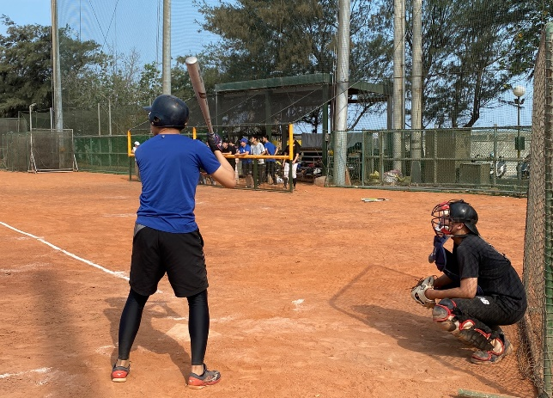
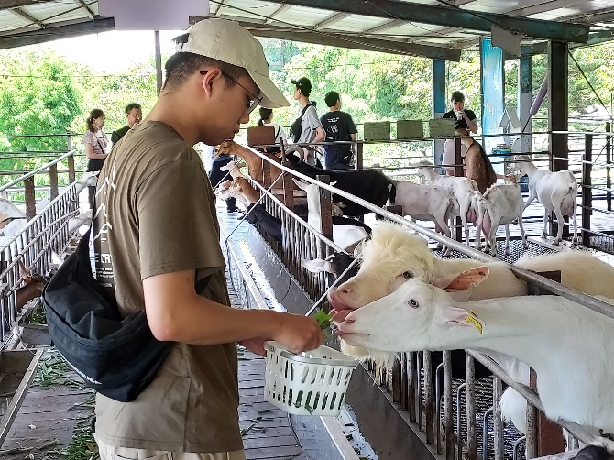






Self Introduction
蘇柏瑜 Brian-Su | DMIS-AW0360
NSYSU Computer Science | WCMC Lab Wireless network Communication
brian09088
2018-2022
NCU Math-Science
2020 / 2022 Summer
Military Service
Army 257 Brigade
2023/07-2023/08
WNC Summer Internship
2015-2018
National Experimental High School
(Central TW Science Park)
2020-2022
Minor-specialty:
Computer Science & Programming
2021-2023
Online-Tutor
2023-02~
Graduate student
Computer-Science Engineering
NSYSU-WCMC Lab

Slide 3
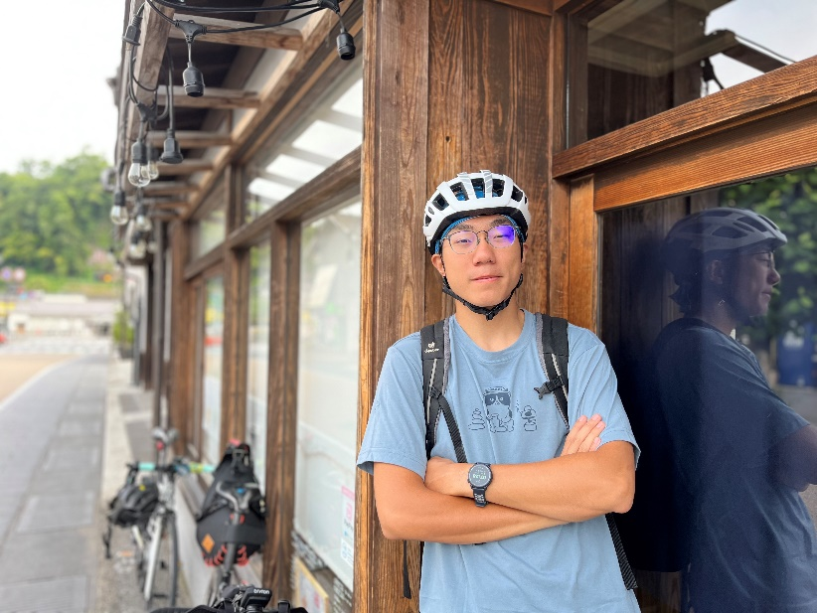
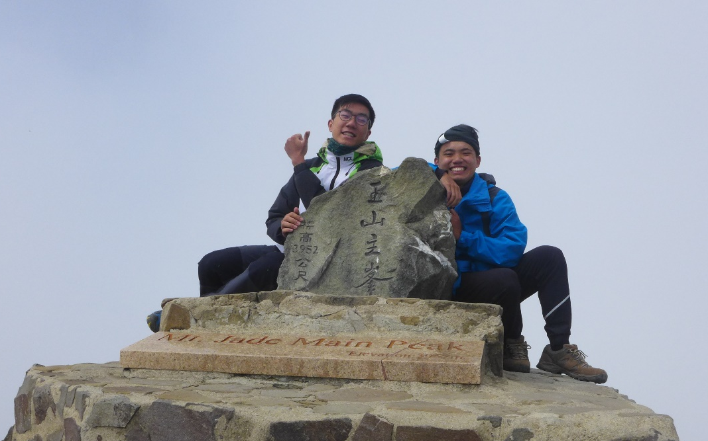
Self Introduction
Name: Schumi Weng 翁國哲
Department: JIR810
Master Students in Environmental Engineering, NCKU
Interest: cycling, outdoor activities

Slide 4
Self-Introduction
Name: Kent Tan 陳建豪
Nationality: Malaysian
Education:
Shanghai Jiao Tong University (Sept 2018- JUN 2022)
Bachelor program in School of Aeronautics and Astronautics
Recipients of Chinese Government Scholarships
National Cheng Kung University (Sept 2022- )
Master program in Institute of Aeronautics & Astronautics
Research Topic: Flame Stability and Emission Characteristics of Fuels in Gas Turbine Combustor
Language: Chinese/English/Hokkien/Malay

Slide 5

Self - Introduction
Name : Jacky Hung
Department : T5R303
Research and develop : AGL-Like Kernel Hardening & AppArmor
University : National Changhua University of Education (NCUE)
Master's degree : Computer Science and Information Engineering
Hobby : Playing basketball 、Watching movies

Slide 6
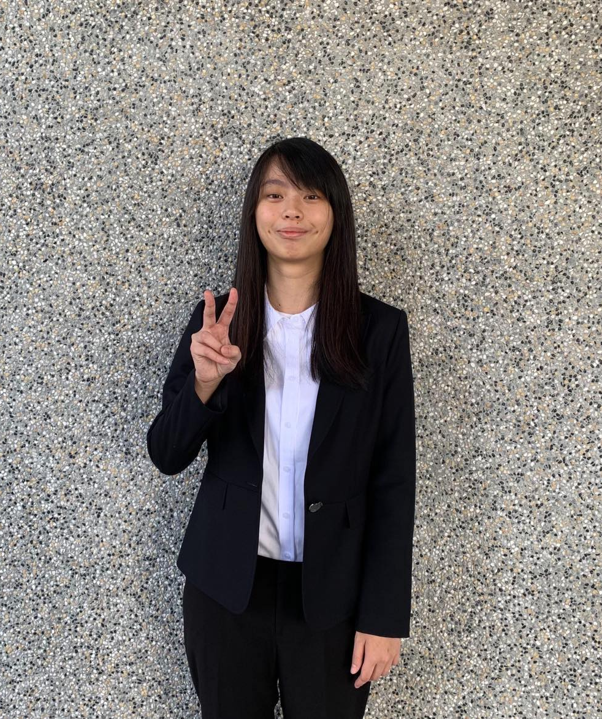
Self-Introduction
Name: YiHan Wu (吳苡菡)
Department: Connected Home – H1R101
School: NCU
Major: Computer Science
Lab: Computer Architecture and System Technologies Lab
Research field: Non-volatile memory systems for machine learning
Expertise: Embedded system, Emerging memory, Wi-Fi networking

Slide 7
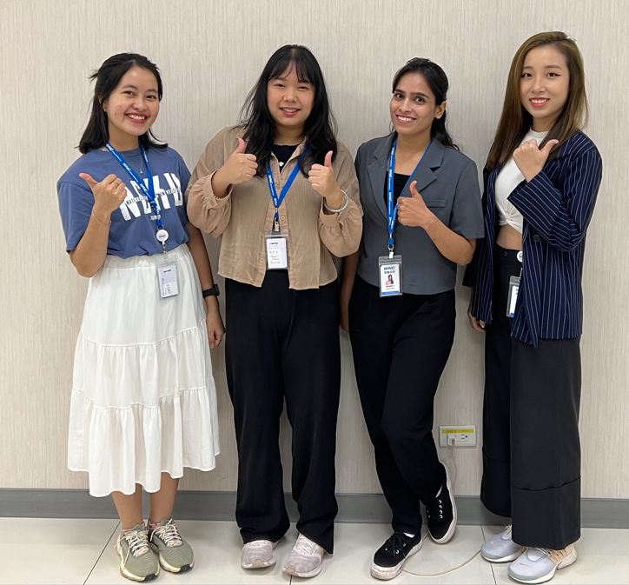
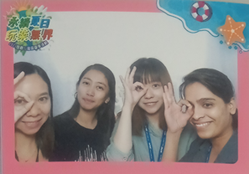
About me :-
Name: Devika Verma
Nationality: Indian
Educational Background:
BSc in Physics and Mathematics
Master's degree in Mathematics
Current Pursuit:
Currently pursuing Master's degree in Physics from NCKU.
[from India]
Department name and Role as an intern in WNC:
worked as an intern in S1 site under M50010 department.
Role in the Project:
Data Collection and analysis: I contributed to the data collection by using the VR scanning machine and fillet height to measure and ensure data are within specs.
Motivation: Understanding the significance of Underfill in the electronics industry.

Slide 8
Feedback
Brian: When developing projects and research work in the unit, I feel the spirit of teamwork and mutual assistance. I am honored to be able to try new system service optimization feasibility, performance analysis and establish a new report query mechanism for the team in the past two months. I also benefited a lot during the internship process. I participated in some online courses and lectures, learned To what many industries are facing. It is beneficial for me to integrate with the workplace in the future and to adapt and prepare early.
Schumi: Thanks WNC for providing me with internship opportunities through the industry-academia collaboration program. Over these two months, I have experienced the working life and come to realize the importance of cherishing precious vacation time. Sometimes, I am motivated to exercise and relax more before and after work. I have enjoyed experiencing the facilities of the hotel and have gained a deeper understanding of Hsinchu, a city at the forefront of the technology industry. During the internship period, I have made significant progress in project milestones, and I hope that the outcomes of the project can contribute to WNC's efforts in promoting the production of more sustainable products.
Kent: This internship has made me realized my lack of skills and the fact that learning is not only limited to the knowledge in books, but also on the skills needed in future career. Throughout the tasks assigned by department , I had several discussions with my mentor. He helped me a lot and inspire me that my thinking is rigid and I have to be more creative instead of limiting myself with some inflexible ideas. I am grateful that WNC has provided us with this opportunity for leaning and helped us with accommodation and transportation issues.

Slide 9
Feedback
Jacky: Unlike the professional knowledge that I have learned in the past, I have learned the skills that can be truly applied in the real workplace, how to find resources and how to cooperate with others in the process of solving problems, and at the same time, I realized that I still have a lot of areas to improve in terms of skills. This two-month internship is an important step in my career development. I would like to thank the team for their help and the company for providing me with such a valuable learning opportunity.
YiHan: Through the summer internship project, not only do I learn how to solve the problems encountering in the project, but I learn how to cooperate with colleagues. I make friends with lots of people and attain unforgettable experience, which let me have a positive attitude to my future career.
Devika: Memories in WNC :- Working as an intern in WNC was a standout memory. Every morning strategy sessions Supportive mentorship Learning new technology Company wide events These memories continue to influence my career aspirations. The lessons learned and connections made during my internship at WNC have set a positive trajectory for my future endeavors.

Slide 10
Q & A
請問 CEO 您作為公司的領導者，您在當前市場環境中看到了哪些挑戰和機會 ?
未來碳權交易對啟碁的影響 ?
對於產品製造過程更永續的改善，公司是如何考量其利弊 ?
認為想進科技業的新鮮人最需要具備什麼樣的能力、特質 ?
What factors or habits do you think are important for your achievements?

